Slide 1

Surya Group Of Institutions
SADHASIVAM M
422221104032
eBPL-Artificial Intelligence
Team-08

Slide 2

AI-Driven Exploration and Prediction of Company Registration Trends with Register of Companies Using Python
Welcome to our presentation on AI-Driven Exploration and Prediction of Company Registration Trends. In this session, we will explore how Python, together with the Register of Companies, can provide valuable insights and predictions for businesses.

Slide 3

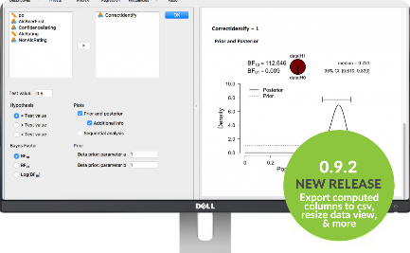
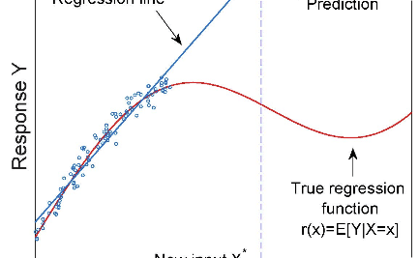
Introduction to Register of Companies
Streamlined Registration
Data Analysis
Predictive Insights
Learn how Python's powerful data analysis capabilities can help us extract meaningful information from the Register of Companies' data.
Explore how AI algorithms can be applied to the company registration data to deliver accurate predictions and valuable insights.
Discover how the Register of Companies simplifies the registration process, reducing paperwork, and improving efficiency.

Slide 4
The Power of Python
1
Data Extraction
2
Data Cleaning
Discover how Python's libraries allow us to extract relevant data from the Register of Companies with ease and efficiency.
Learn how Python helps us clean and preprocess the extracted data, ensuring accurate and reliable analysis results.
3
Statistical Analysis
4
Machine Learning
Explore the statistical tools and techniques in Python that enable us to analyze and interpret the company registration trends effectively.
Understand how Python's machine learning capabilities allow us to build predictive models based on the company registration data.

Slide 5

The Register of Companies' Potential
1
Market Trends
Unveil market trends by analyzing the company registration data from different industries and sectors.
Competitor Analysis
2
Gain a competitive edge by exploring the company registration trends of your competitors and identifying potential business opportunities.
3
Risk Assessment
Assess the risk of investing in a specific industry or sector by analyzing the registration trends and financial stability of the companies.

Slide 6
Unlocking Business Insights
Data Visualization
Pattern Recognition
Visualize the company registration trends using Python's powerful plotting libraries, turning raw data into actionable insights.
Discover hidden patterns and correlations in the company registration data, enabling informed decision-making and strategy development.
Identifying Opportunities
Predictive Analytics
Identify emerging market opportunities and potential gaps in the industry by analyzing the registration trends of successful companies.
Use advanced algorithms to predict future company registration trends, allowing proactive business planning and resource allocation.

Slide 7

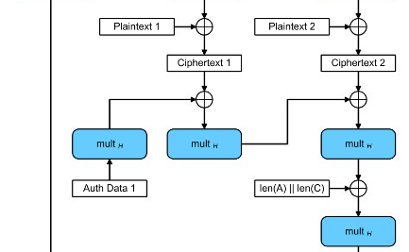

Data Security and Privacy
Ensuring Security
Secure Data Transmission
Strict Privacy Measures
Learn how we prioritize data security and privacy to ensure the protection of sensitive company registration information.
Discover our commitment to compliance with privacy regulations, ensuring the responsible handling and storage of company registration data.
Explore the encryption protocols and secure transmission methods we employ to safeguard data during extraction and analysis.

Slide 8
Real-World Applications
1
Market Research
2
Investment Planning
Utilize the insights derived from the Register of Companies to conduct comprehensive market research and make data-driven business decisions.
Assist investors in making informed investment decisions by providing accurate predictions and risk assessments based on company registration trends.
3
Government Policy
4
Industry Analysis
Support policymakers by providing valuable insights into the economic landscape and the impact of regulations on company registration activities.
Help industry analysts and consultants identify emerging trends, market opportunities, and potential risks based on comprehensive company registration data.

Slide 9
Getting Started
Installation
Data Access
Learn how to install and set up the necessary Python libraries and dependencies to begin exploring the Register of Companies' data.
Understand the process of accessing the Register of Companies and retrieving the relevant data for analysis using Python.
Exploratory Analysis
Predictive Modeling
Get hands-on with Python to perform exploratory analysis on the company registration data, uncovering valuable insights.
Discover how to build predictive models using Python and apply them to the company registration data for future trend forecasting.

Slide 10
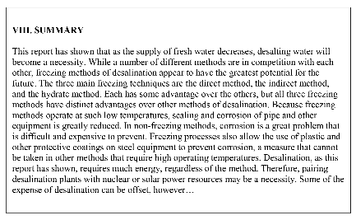


Conclusion
Data-Driven Decision Making
The Power of Python
Achieve Business Success
Highlight the versatility and capabilities of Python in extracting, analyzing, and predicting company registration trends.
Reinforce the importance of data-driven decision-making and the role of the Register of Companies in providing valuable insights for businesses.
Empower businesses with the knowledge and tools to leverage data and make informed decisions, driving growth and success.

